Slide 1
Research Practice By N. Sai Charan under
Dr. Abhishek Mishra
Dr. Abhishek Mishra N. Sai Charan
Assistant Professor, M. Engg - Software Systems,
Department of Computer Science & Information Systems Department of Computer Science &
Birla Institute of Technology & Science, Pilani. Information Systems
Birla Institute of Technology & Science, Pilani

Slide 2
Research Topic
Scheduling Directed Acyclic Graphs with Optimal Duplication Strategy on Homogeneous Multiprocessor systems.
Objective: Assigned theoretical task to study the paper carefully and get the experimental results by solving the MILP

Slide 3
Agenda
Recap of previous presentation
Optimality Theorems in brief
MILP formulation
Task Execution Constraints
Data Dependency Constraints
Implementation Details
Code Walkthrough

Slide 4
Quick Recap
When tasks of the application are mapped onto different processors for execution, inter-processor communications occurs between the tasks among processors.
Due to inter processor communication overhead in multi – processor system, we go for Task Duplication Strategy.
Task duplication based scheduling algorithms generate shorter schedules without sacrificing efficiency but leave the computing resources over consumed due to the heavily duplications of tasks.
Finding the optimal duplication-based solution with the minimal schedule make span remains an issue.

Slide 5
Quick Recap
Issues with Duplication:
Which task(s) to be duplicated?
How many times a task should be duplicated and where it should be duplicated?
How should tasks on each processors be ordered and timed?
How to determine the data precedence among duplications of a task and its successors?
Mixed Integer Linear Programming Approach:
This paper proposes a novel Mixed Integer Linear Programming (MILP) formulation, together with a set of key theorems which enable and simplify the MILP formulation and solve the problem with optimality.

Slide 6
Complete Overview
Task Scheduling
Duplication Strategy
Optimal Duplication (MILP)
IPC Overhead
Tasks are duplicated to processors where dependents exist to avoid IPC (Full Duplication Strategy)
Redundant Duplications are not executed.

Slide 7
Optimality Theorems in Breif
Lemma I: This ensures that each processor have a unique set of tasks.
Addresses the issue of how tasks should be mapped to processors.
Theorem I: This says that there will be one to one dependency between source and destination tasks if at all dependency exists.
Resolves the issue of Data Precedence.
Theorem II: This ensures that there will be definite dependency between the source and the duplicated tasks among processors i.e. no useless executions taking place.
Resolves the issue of Redundant duplications.
Theorem III: This says that though a,b tasks are mapped to different processors and there might be difference in execution time, but b will be mapped to some other task a on some processor thus satisfying the dependency.

Slide 8
Optimality Theorems contd.
This is represented as drt_{bk} = f_{ai} + w(e) ≥ f_{aj} + w(e) + c(b) + c(a) + w(e), where the data ready time of bk is obtained by redirecting the input data of bk from ai to aj the new maximal data ready time of bk _{i.}
Theorem IV: If one dependent task executes before source task, then logically, all its dependent tasks can be mapped to other source making the original source node redundant.
This is represented as c(v) + w(e1) + c(dst(e1)) ≥ w(e2), ∀e1, e2 ∈ oe(v), e1 ̸= e2
Out of all the duplication-based schedules, there should be at least one schedule that obeys these optimality theorems which is the optimal solution.

Slide 9
MILP Formulation
Constraints on Order of Task Execution:
Entry task should execute only once.
X_{mi} + X_{mj} = 1, ∀ m ∈ {a, b}
Non entry task can be executed >= 1 times.
X_{vi} + X_{vj} ≥ 1
When a redundant duplication is found, its Start Time should be limited to zero i.e the Redundant task never gets executed in the schedule.
S_{mk} ≤ M ∗ X_{mk} , ∀ m ∈ {a, b}, k ∈ P

Slide 10
Task Execution Constraints:
If both Source task and Dependent task are mapped to same processor, then their execution should be ordered i.e. Source task should execute before the Dependent task.
f_{vk} − S_{mk} ≤ M ∗ (2 − X_{vk} − X_{mk)}, ∀ m ∈ {a, b}, k ∈ P
Since there are dependents to the task, the Finish time of the Source task and Start Times of the Dependent tasks should be ordered.
f_{ak} − S_{bk} ≤ M ∗ (2 − X_{ak} − X_{bk} ) + M ∗ Z_{a,b,k}, ∀ k ∈ P
f_{bk} − S_{ak} ≤ M ∗ (2 − X_{ak} − X_{bk} ) + M ∗ (1 − _{Za,b,k}), ∀ k ∈ P

Slide 11
Data Dependence Constraints:
Constraints on Dependencies between Tasks:
There should be atleast one dependent successor task for a source task to be irredundant.
d_{vkml} ≤ X_{vk} , ∀ m ∈ {a, b}, k, l ∈ P
Redundant dependencies should be removed as these result in redundant duplications.
d_{viai} + dv_{iaj} + d_{vibi} + d_{vibj} ≥ X_{vi}
d_{vjai} + d_{vjaj} + d_{vjbi} + d_{vjbj} ≥ X_{vj}

Slide 12
Data Dependence Constraints:
The successor dependent task should depend only on one source task in the schedule.
d_{vimi} + d_{vjmi} = X_{mi} , ∀ m ∈ {a, b}
d_{vimj} + d_{vjmj} = X_{mj} , ∀ m ∈ {a, b}
Since tasks are dependent, the dependent task should start execution right after the finish time of the source task.
f_{vi} − S_{mi} ≤ M ∗ (1 − d_{vimi} ), ∀ m ∈ {a, b}
f_{vj} − S_{mj} ≤ M ∗ (1 − d_{vjmj} ), ∀ m ∈ {a, b}

Slide 13
Implementing MILP
The MILP formulation is solved using the IBM ILOG CPLEX Optimization Studio IDE 20.1.0
Other MILP solvers like lp_solve, Gurobi also can be used.
A DAG consisting of 9 tasks, with Communication and Computation Times is chosen.
Indices, Parameters, Data, Decision Variables were initialized as per the proposed MILP in the Research paper.
The objective function is chosen accordingly and the Task Execution constraints and Data dependency constraints were imposed in solving the MILP.
The MILP is solved in two different ways for observing the effect of proposed constraints.

Slide 14
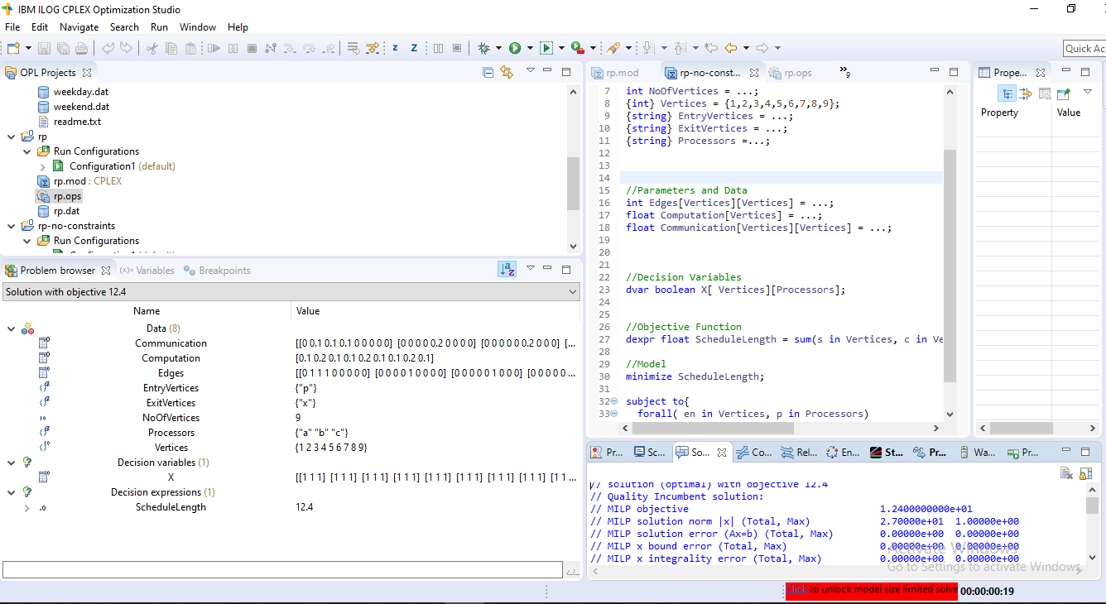
Implementing MILP
Firstly the MILP is solved with an Objective of finding minimal schedule length, without having any constraints imposed.
On solving, this gave a Schedule Length of 12.4 ms.

Slide 15
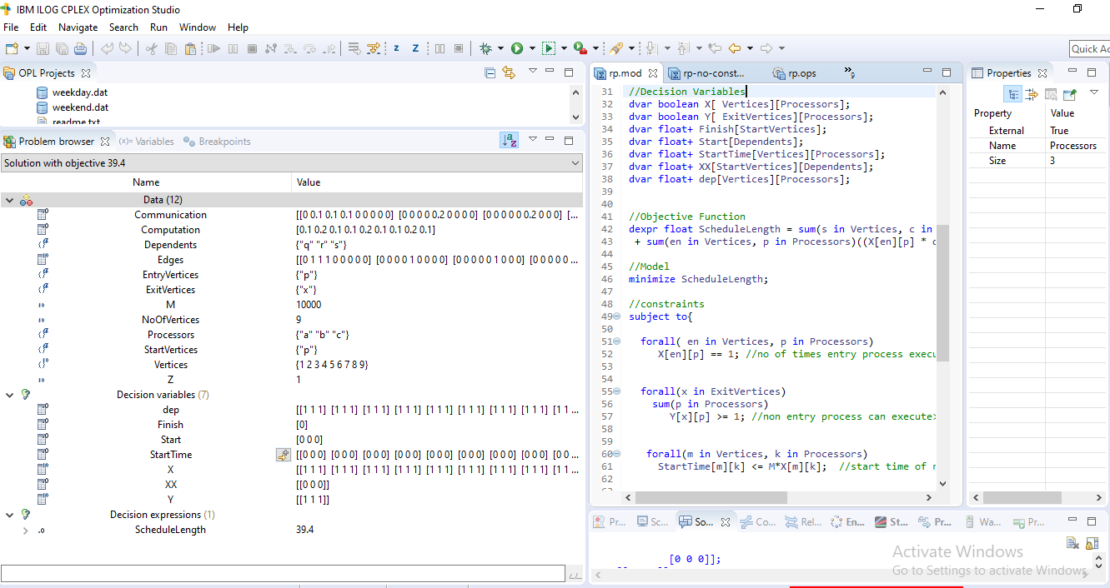
Implementing MILP
Task Execution constraints and Data Dependency Constraints were imposed on the MILP.
On solving, Schedule Length is found to be 39.4 ms.

Slide 16
Thank You !!

